Slide 1
BLOCKCHAIN-BASED
ACADEMIC CERTIFICATE
VERIFICATION
Review – 2 Presentation
Team Members: ID Number:
G.SIRI 2300030208
K.SIRISHA 2300030806
P.MOUNIKA 2300033496
N.KARTHIVANI 2300030475
01

Slide 2
PROBLEM STATEMENT
• Manual academic certificate verification can be time-consuming and difficult to trace.
• Forged or modified certificate documents may not be easy to detect by visual inspection alone.
• A verifier needs a trusted reference record against which the submitted certificate can be checked.
• The project combines SHA-256 hashing, blockchain, IPFS, QR verification and ESP32-CAM.
• Synthetic/demo certificates are used for the prototype and are clearly labelled DEMO / PROTOTYPE.
CORE IDEA
Compare the certificate against a trusted registered record and show a clear verification result.
02

Slide 3
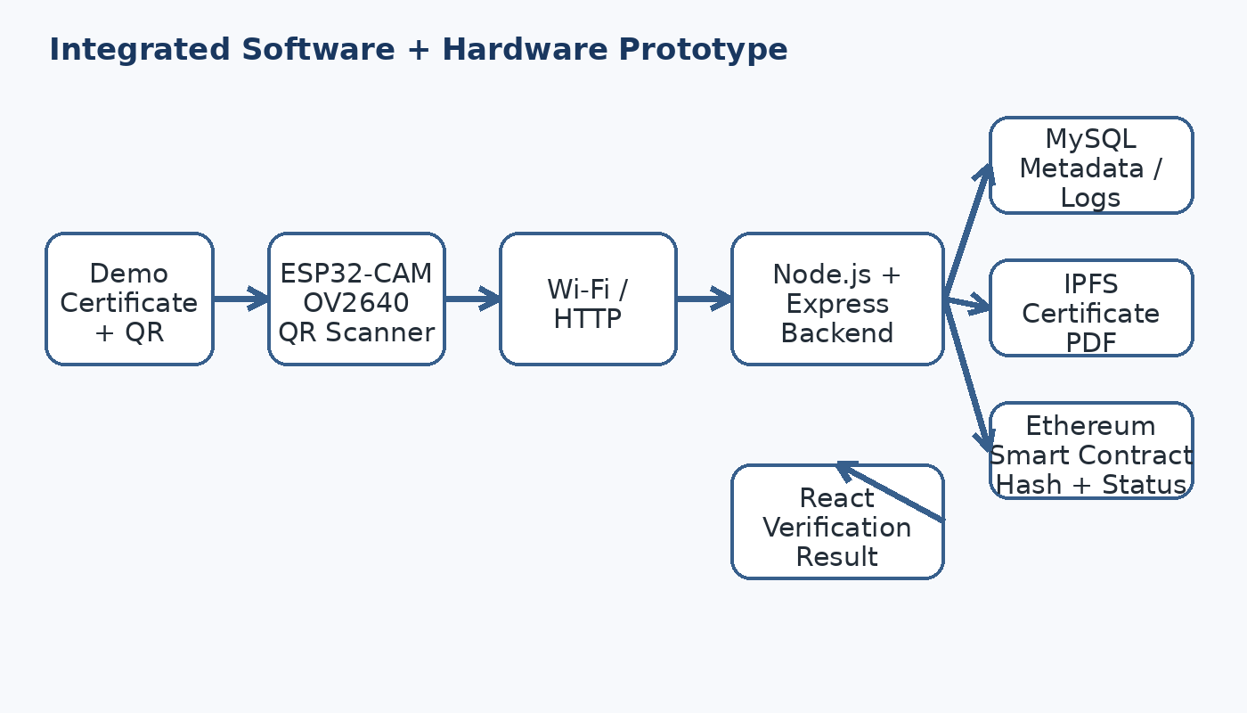
SYSTEM ARCHITECTURE
03

Slide 4
FRONTEND IMPLEMENTATION
• React.js is used for the web interface.
• Role-based access: Admin, Student, Employer / Verifier.
• Admin: certificate registration, status management and verification logs.
• Student: certificate details, download and QR / Certificate ID sharing.
• Employer: Certificate ID search and QR-based verification.
• Result page displays VERIFIED, VERIFIED or INVERIFIED/TAMPERED.
ADMIN
Register • Manage • Verify
STUDENT
View • Download • Share
EMPLOYER
Scan • Verify • Report
04

Slide 5
BACKEND IMPLEMENTATION
• Node.js + Express.js provides the REST API layer.
• JWT authentication and bcrypt protect user accounts.
• MySQL stores users, certificate metadata and verification logs.
• SHA-256 is calculated from the certificate PDF for integrity checking.
• Ethers.js connects the backend to the Ethereum smart contract.
• IPFS stores the certificate PDF and returns its CID.
AUTH
JWT + bcrypt
DATABASE
MySQL
BLOCKCHAIN
Ethers.js + Smart Contract
STORAGE
IPFS + SHA-256
05

Slide 6
BLOCKCHAIN, IPFS & SMART CONTRACT
• The smart contract stores the trusted Certificate ID, SHA-256 hash, IPFS CID and status.
• IPFS stores the actual certificate PDF; the CID identifies the stored content.
• Blockchain provides a tamper-resistant reference record.
• MySQL stores application metadata and verification logs.
• Admin can move a registered certificate from ACTIVE to VERIFIED through the authorized workflow.
SHA-256
Certificate file fingerprint
IPFS
Certificate PDF + CID
BLOCKCHAIN
Hash + CID + Status
06

Slide 7
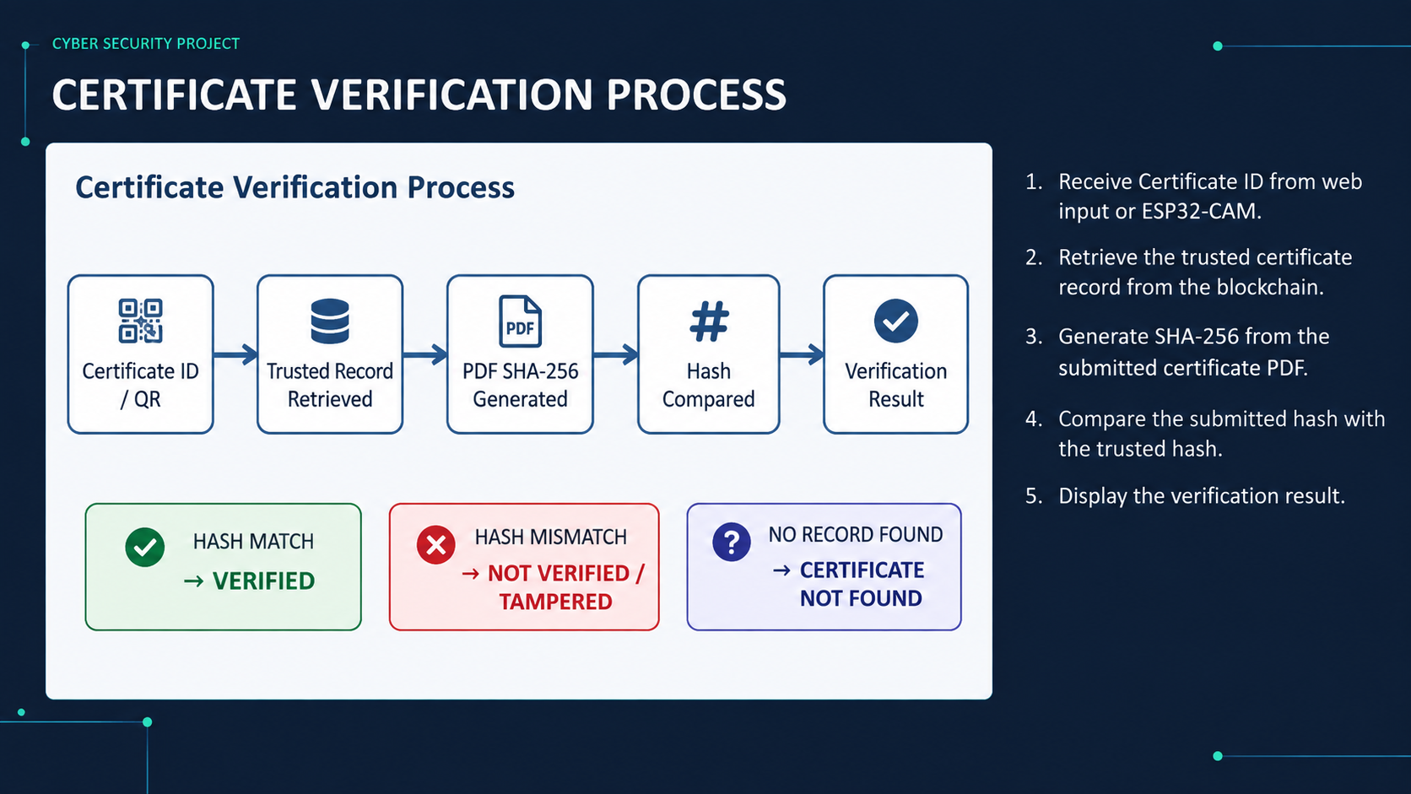

Slide 8
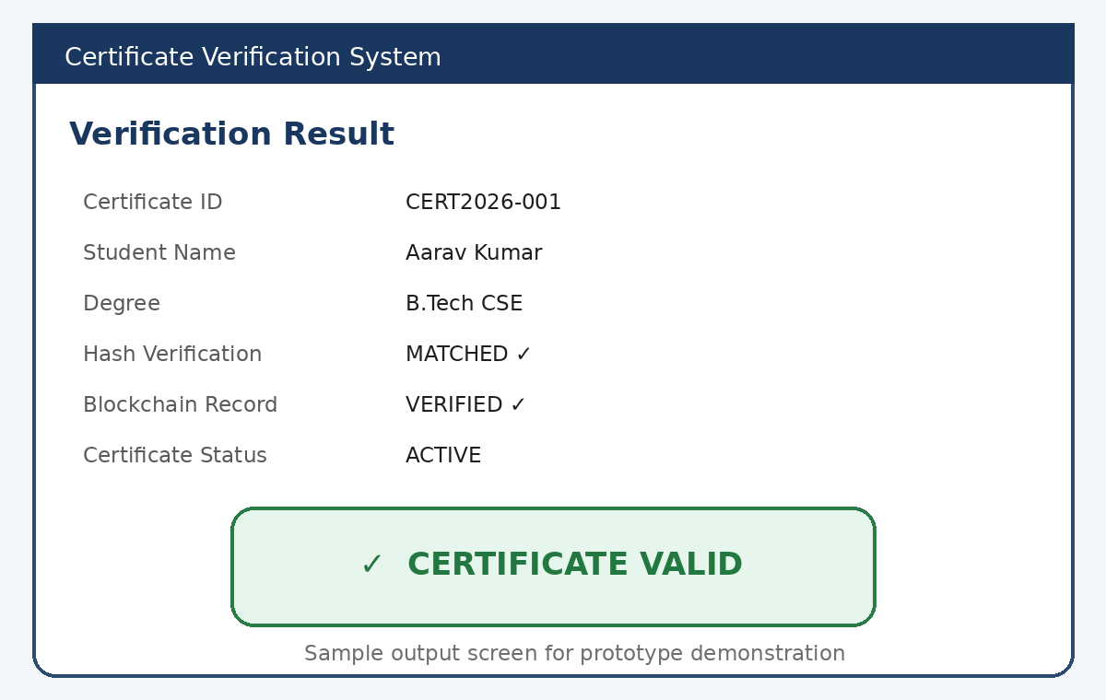
RESULTS
VERIFIED
Hash matched + status ACTIVE
VERIFIED
Hash matched + status VERIFIED
INVERIFIED / TAMPERED
Submitted hash does not match
Sample software output
08

Slide 9
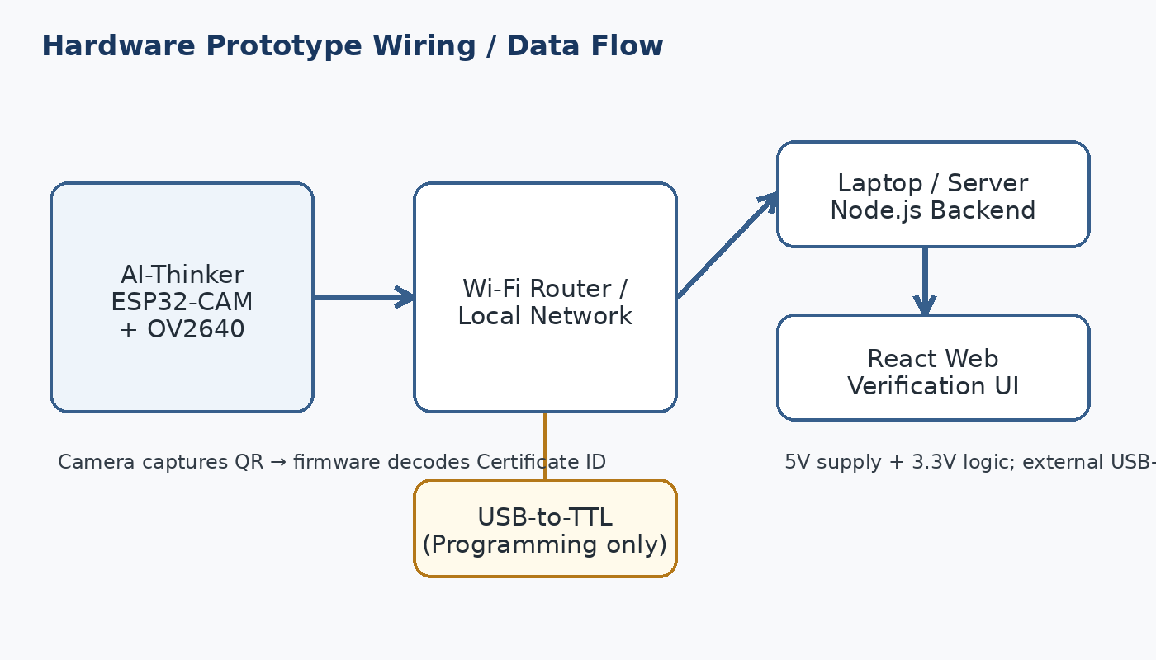
HARDWARE INTERFACING
• Hardware: AI-Thinker ESP32-CAM with OV2640.
• Camera reads the QR code printed on the demo certificate.
• ESP32-CAM obtains the Certificate ID.
• Certificate ID is sent to the Node.js backend over Wi-Fi/HTTP.
• Backend performs the verification and React displays the result.
• USB-to-TTL is used for programming the ESP32-CAM.
ESP32-CAM QR scanning data flow
09

Slide 10
TESTING & EVALUATION
• Development: VS Code, Node.js, React, MySQL and local/test Ethereum network.
• API testing: Postman.
• Test data: synthetic certificates with ACTIVE and VERIFIED states.
• Test cases: valid certificate, verified certificate, tampered certificate and unknown Certificate ID.
• Hardware test: ESP32-CAM scans the QR and sends the ID through Wi-Fi.
• Verification logs are stored for traceability.
TEST 01
VERIFIED certificate
TEST 02
VERIFIED certificate
TEST 03
Tampered PDF
TEST 04
Unknown ID
10

Slide 11
RESOURCE & RISK MANAGEMENT
SOFTWARE RESOURCES
HARDWARE RESOURCES
RISKS & MITIGATION
React.js
Node.js + Express
MySQL
Solidity + Ethers.js
IPFS
Git / GitHub
Postman
AI-Thinker ESP32-CAM
OV2640 camera
USB-to-TTL programmer
Jumper wires
5V power
Wi-Fi router
QR failure → manual ID
Network failure → local network
IPFS/blockchain issue → test environment
Modified PDF → SHA-256 mismatch
11

Slide 12
CONCLUSION & FUTURE ENHANCEMENT
CONCLUSION
FUTURE ENHANCEMENT
• Integrated software + hardware certificate verification prototype.
• SHA-256 checks document integrity.
• Blockchain stores the trusted reference/status record.
• IPFS stores certificate documents.
• ESP32-CAM provides QR-based physical input.
• React displays VERIFIED, INVERIFIED/TAMPERED or no certificate
found.
• Integrate authorized institutional records.
• Add stronger digital identity/signatures.
• Cloud deployment and mobile verification.
• Improved document and QR scanning.
• Larger-scale security and performance testing.
12

